Slide 1

Electric Drive Fault Diagnosis System

Slide 2
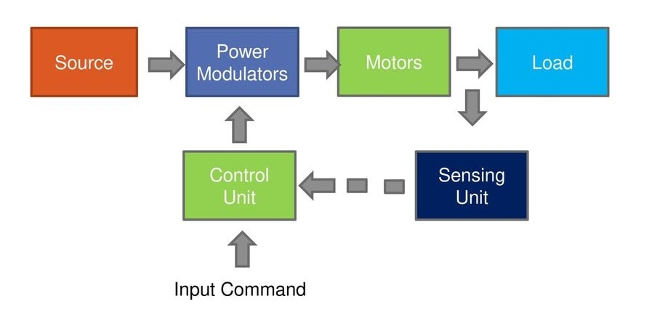
Introduction :
What is an Electric Drive?
Drives that employ Electric motors are known as electric drives. The key role of electric drives is to control and regulate the operation of an electric motor to meet specific performance requirements in various applications.
Electric drives manage the motor's speed, torque, direction, and overall operation to ensure it runs efficiently and precisely. This intelligent control enables precise automation and significant energy savings in industrial processes.
Block Diagram of Electric Drive:
Power Supply: The drive receives electrical power from an AC or DC source.
Control Unit: Regulates voltage, current, and frequency to achieve the desired speed and torque.
Power Converter (Inverter/Rectifier): Converts the input power into a suitable form for the motor.
Electric Motor: Converts electrical energy into mechanical motion.
Feedback System (Sensors): Monitors motor performance and adjusts control parameters for efficient operation.

Slide 3
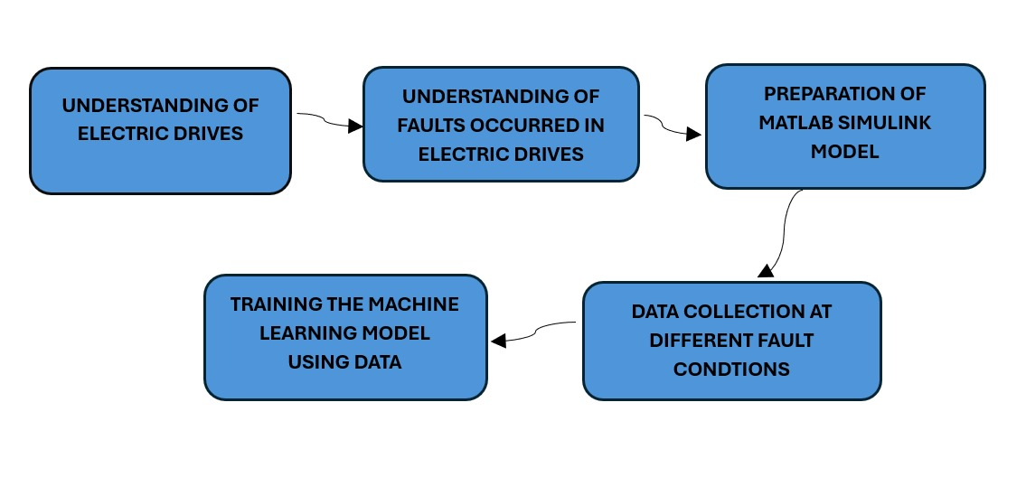
Objectives and Workflow:
Problem Statement
Electric drives are critical components in industrial and commercial applications, requiring high reliability and efficiency.
Various faults, such as voltage issues and short circuits, can lead to failures, causing downtime and financial losses.
Traditional fault diagnosis methods are often manual, time-consuming, and require expert intervention.
Objectives
A trained ML model capable of identifying faults with high accuracy.
Real-time fault detection capability for predictive maintenance.
Reduction in downtime and maintenance costs

Slide 4
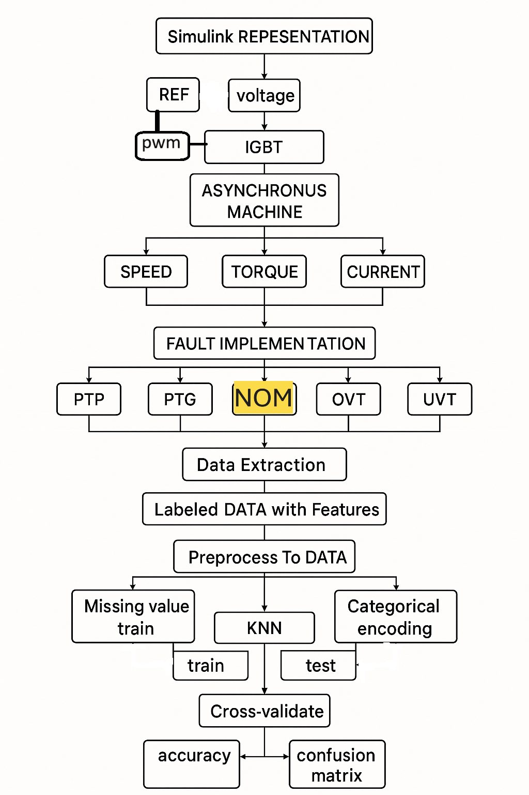
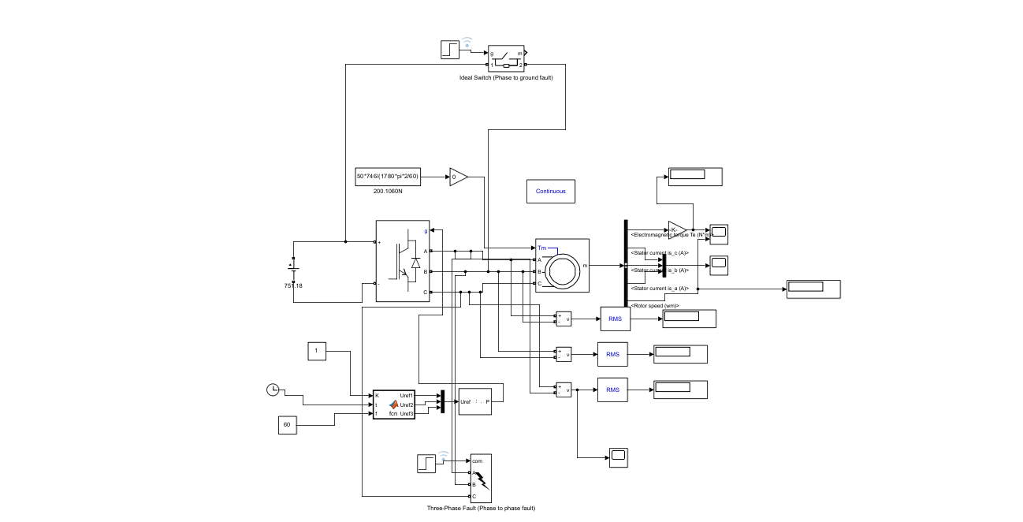
Methodology:
Our comprehensive approach combines advanced simulation techniques with cutting-edge machine learning algorithms to detect and classify faults in three-phase induction motor drive systems.
This model is designed to generate real-time data that can be used for fault classification, prediction, and early detection in electric drives using machine learning algorithms.

Slide 5
Key Components in the Model:
Power Supply Section:
Three-Phase AC Voltage Source: Generates the three-phase AC power needed to operate the induction motor. Can be controlled to simulate variations in input voltage conditions.
Inverter Circuit: Converts DC power to AC forming a Variable Frequency Drive (VFD) for motor speed control.
PWM and MATLAB Function: Controls power delivery to the motor using frequency and clock signals.
Electric Drive (Induction Motor)
The three-phase induction motor (IM) represents the main machine under test. It receives power from the inverter and converts electrical energy into mechanical motion. It outputs torque, speed, and current signals that are critical for fault analysis.
Fault Injection Mechanism:
Phase-to-Ground Fault: Short-circuits one phase to ground, leading to severe current imbalances.
Phase-to-Phase Fault: Simulates inter-phase faults where two phases short-circuit.

Slide 6
Machine Learning-Based Fault Diagnosis:
Data Collection through Simulation:
Simulate normal and faulty conditions to generate labeled datasets. Extract key parameters such as:
Phase currents (ia, ib, ic)
Rotor speed (wm)
Electromagnetic torque (Te)
Voltage waveforms
Store the simulation data for further processing.
Machine Learning Model Selection:
Train a machine learning classifier using extracted features. Suitable models include:
K-nearest neighbour algorithm (knn)
The dataset is divided into training (80%) and testing (20%) for model evaluation.
Model Training and Optimization:
The ML model is trained using labeled fault data. Hyperparameter tuning is performed to improve accuracy. Performance metrics such as accuracy, precision, recall, and F1-score are used for validation.
Deploy the trained model to classify new incoming data as:
Healthy Operation
Minor Fault
Severe Fault
Implement real-time monitoring to detect faults early and trigger preventive action.

Slide 7
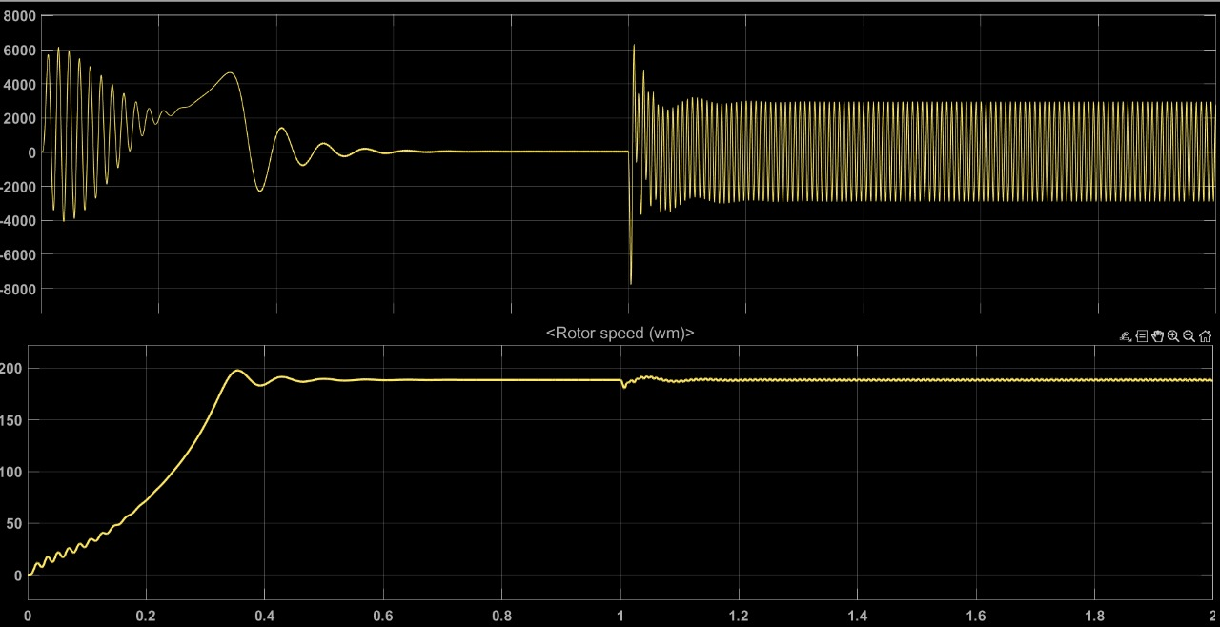
Results for the Project:
Phase-to-Phase Short Circuit:
A phase-to-phase short circuit occurs when two of the three phases make direct contact, leading to abnormal current flow and potential damage.
Detection of Fault
Causes a surge in current in the affected phases. The two shorted phases show abnormally high current, while the third phase remains stable.

Slide 8
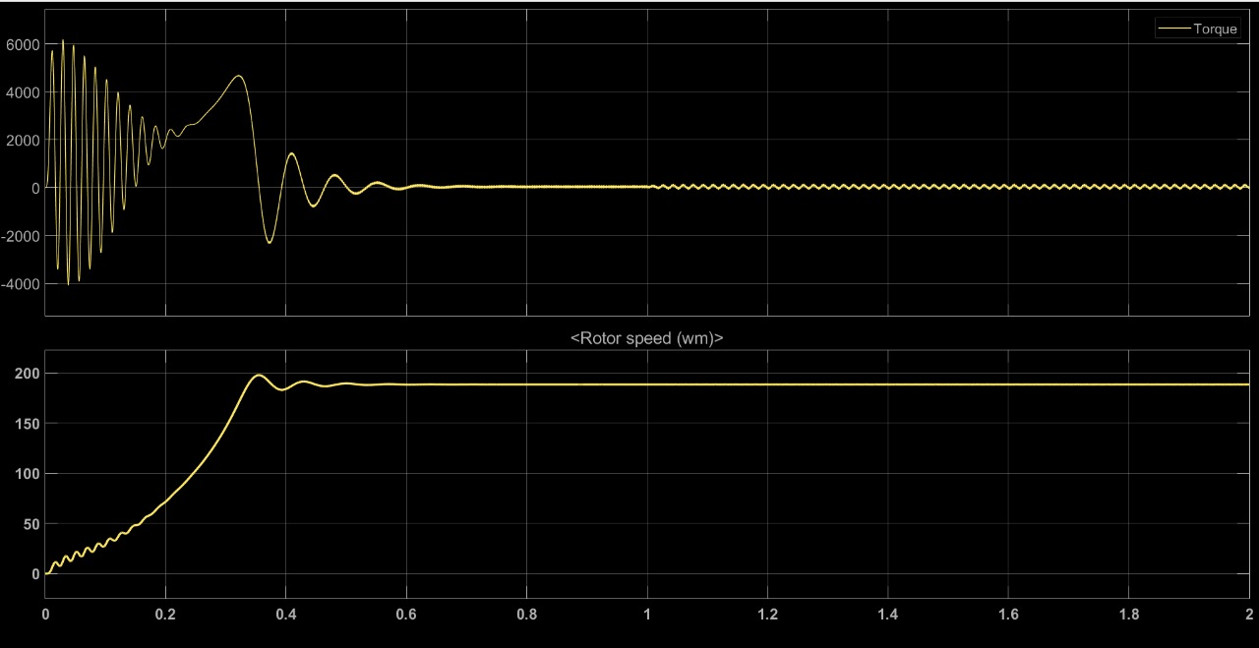
Results for the Project:
Phase-to-Ground Short Circuit:
A phase-to-ground fault occurs when one phase unintentionally contacts the ground or a grounded structure.
Detection of Fault
The affected phase will experience abnormally high current, while the other two phases may show a significant drop.

Slide 9
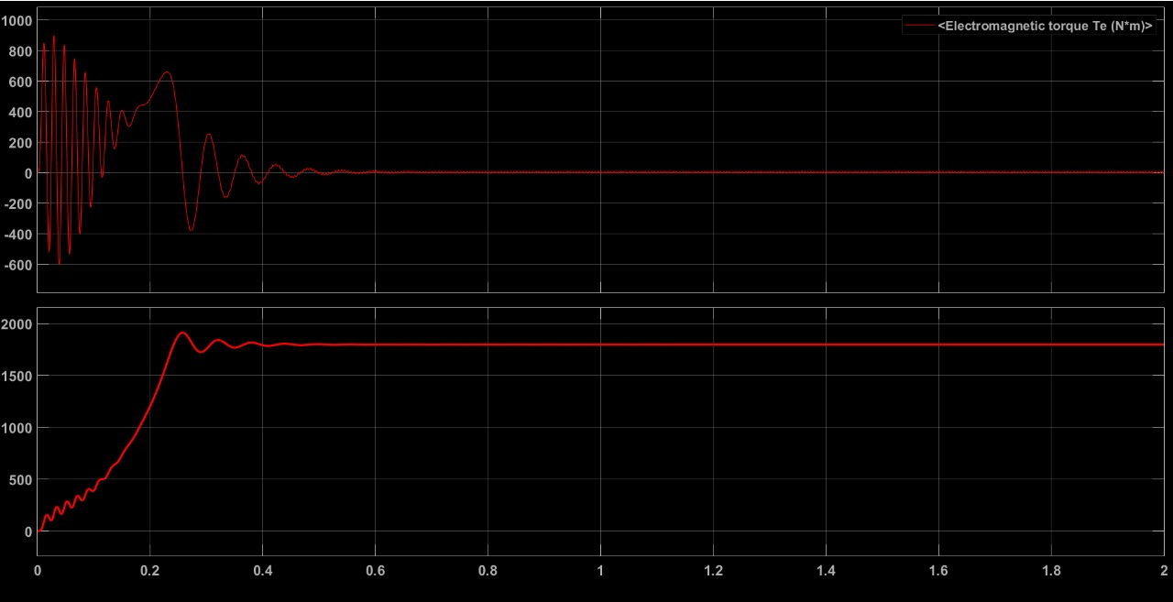
Results for the Project:
Over-Voltage Fault:
An Over-Voltage fault occurs when the voltage in a system exceeds the maximum allowed voltage.
Detection of Fault
Overvoltage can damage equipment, cause electrical fires, and lead to system failures.

Slide 10
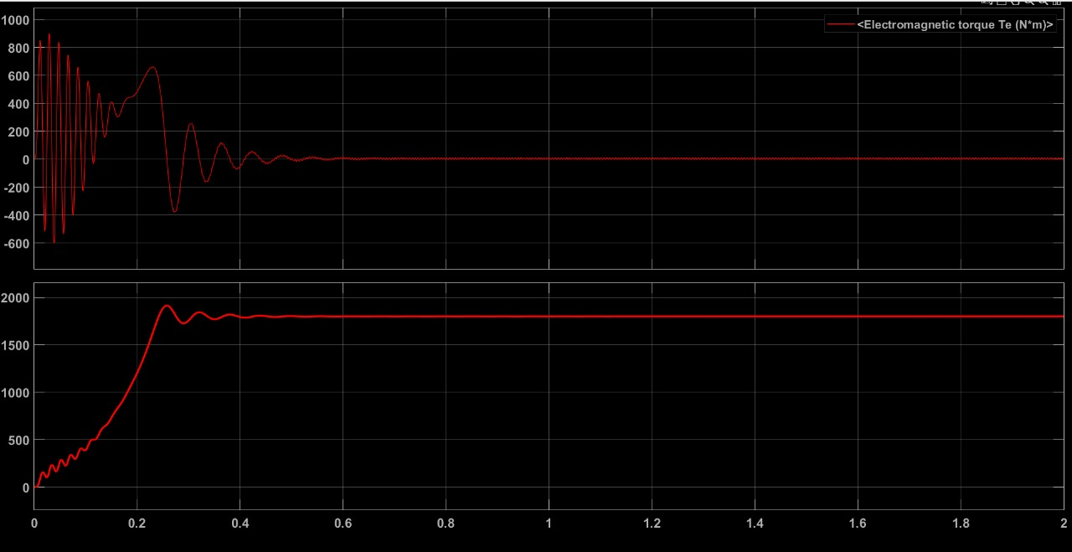
Results for the Project:
Under-Voltage Fault:
An Under-Voltage fault occurs when the voltage in a system drops the minimum allowed voltage.
Detection of Fault
Undervoltage can cause equipment malfunction, reduced system efficiency, and even complete system failures.

Slide 11
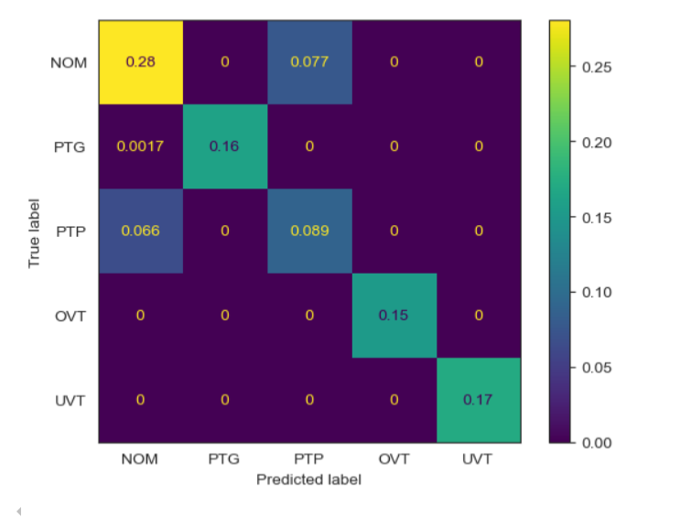
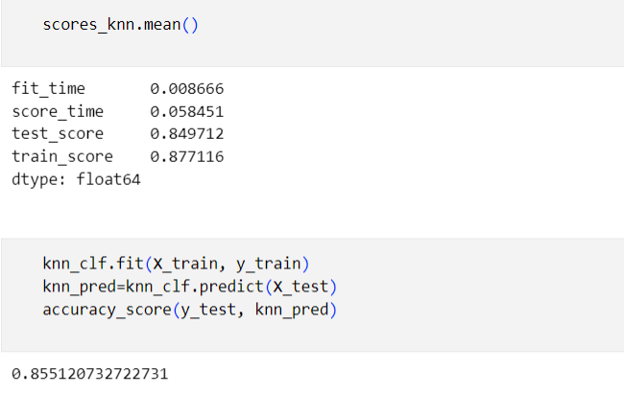
Results in the KNN Model:
Confusion matrix of the model
Accuracy of the Project
The confusion matrix reveals a strong balance between true positives and true negatives, indicating reliable performance.
p>Our fault detection model for electric motors achieved an accuracy of 85.51%, demonstrating its effectiveness in identifying faults.

Slide 12
Project Conclusion:
This project successfully implemented a fault diagnosis system for electric drives using Simulink modeling and K-nearest neighbors (KNN) machine learning. The integrated approach demonstrated high accuracy in detecting and classifying various fault conditions, providing a reliable framework for real-time monitoring of electric drive systems.
The KNN algorithm proved particularly effective at recognizing fault patterns with minimal computational overhead, making it ideal for real-time monitoring of electric drive systems.
Future Implementations
Comparing modelscomparing with differnt machine learning model to get bette accuracy
Deep Learning IntegrationExpand the model to incorporate deep learning techniques for improved fault pattern recognition in complex operating conditions
Real-Time MonitoringDevelop a real-time monitoring system with edge computing capabilities for industrial deployment
Predictive MaintenanceIntegrate predictive maintenance scheduling based on severity analysis of detected faults
Transfer LearningEnhance the system with transfer learning to adapt to different electric drive configurations with minimal retraining
User InterfaceImplement a user-friendly interface with visualization tools for maintenance personnel

